Slide 1
Lecture 27
Memory and Delay-Fault Built-In Self-Testing
Definitions
Static RAM March Test BIST
SRAM BIST with a MISR
Neighborhood Pattern Sensitive Fault (NPSF) DRAM BIST
Transparent testing
Complex examples
Delay fault BIST
Summary

Slide 2
Definitions
Concurrent BIST – Memory test that happens concurrently with normal system operation
Transparent testing – Memory test that is non-concurrent, but preserves the original memory contents from before testing began

Slide 3
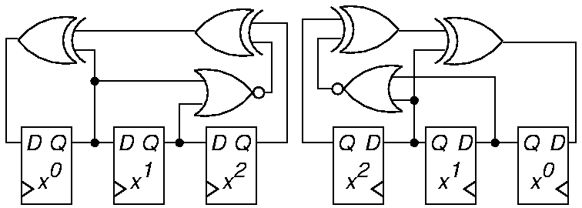
LFSR and Inverse Pattern LFSR
NOR gate forces LFSR into all-0 state
  Get all 2^{n} patterns
Normal LFSR:
  G (x) = x³ + x + 1
Inverse LFSR:
  G (x) = x³ + x² + 1

Slide 4
Up / Down LFSR
Preferred memory BIST pattern generator
  Satisfies March test conditions
0
M
U
X
0
M
U
X
1
1
D
Q
0
M
U
X
D
Q
0
M
U
X
D
Q
X₀
1
X₁
1
X₂
Up/Down

Slide 5
Up / Down LFSR Pattern Sequences
Up Counting
000
100
110
111
011
101
010
001
Down Counting
000
001
010
101
011
111
110
100

Slide 6
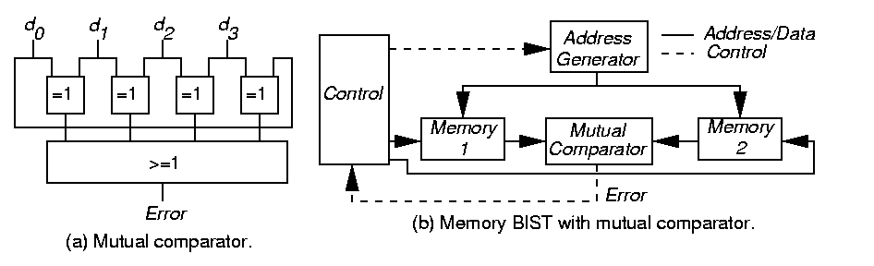
Mutual Comparator
Test 4 or more memory arrays at same time:
  Apply same test commands & addresses to all 4 arrays at same time
  Assess errors when one of the d_{i} (responses) disagrees with the others

Slide 7
Mutual Comparator System
Memory BIST with mutual comparator
Benefit: Need not have good machine response stored or generated

Slide 8
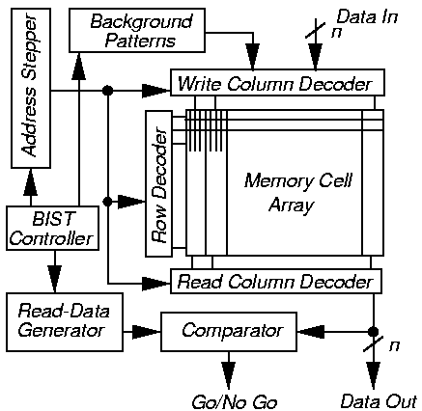
Parallel Memory BIST

Slide 9
Parallel Memory March C
Add MUX to inputs of write drivers:
  Selects normal data input or left neighbor sense amplifier output
    Creates shift register during self-test
Generalize any March test to test n-bit words in array rows
(x)^{n} means repeat x operations n times
Example: March C^{n}
{ (w0)^{n} (r0, w0)^{n}; (r0, w1)^{n} (r1, w1)^{n};
(r1, w0)^{n} (r0, w0)^{n}; (r0, w1)^{n} (r1, w1)^{n};
(r1, w0)^{n} (r0, w0)^{n}; (r0, w0)^{n} (r0, w0)^{n}}

Slide 10
MATS+ RAM BIST
For single-bit word – can generalize to n-bit words
Need Address MUX – switch row decoder from normal input to address stepper (which is the Up/Down LFSR)
# states needed:
  2 x # March elements + 3
Three extra states:
  Start Error Correct
Chip area overhead: 1 to 2 % -- widely used

Slide 11
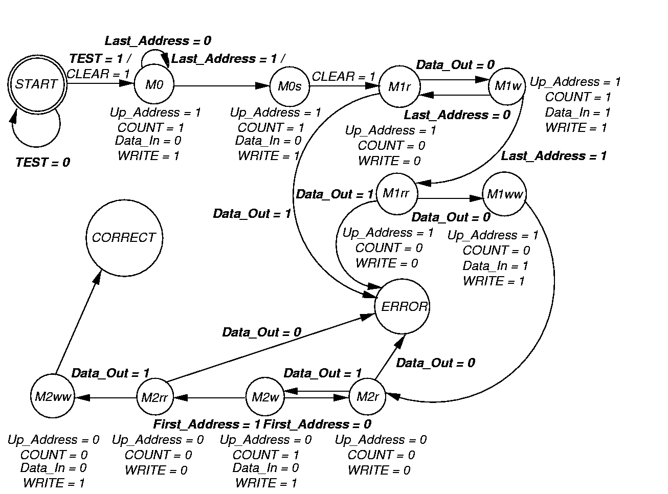
State Transition Diagram
For MATS+ Memory BIST

Slide 12
SRAM BIST with MISR
Use MISR to compress memory outputs
Control aliasing by repeating test:
  With different MISR feedback polynomial
  With RAM test patterns in reverse order
March test:
  { (w Address); (r Address); (w Address);
  (r Address); (r Address); (w Address);
  (r Address); (r Address) }
Not proven to detect coupling or address decoder faults

Slide 13
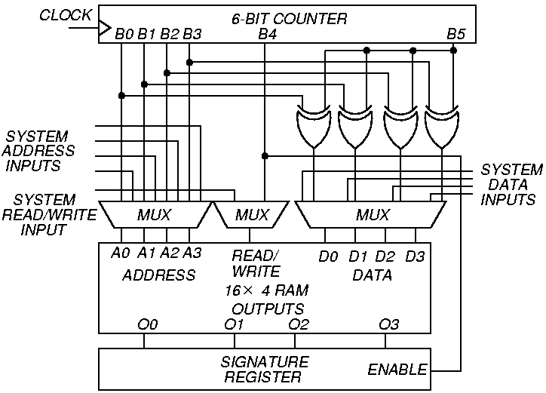
BIST System with MISR

Slide 14
Neighborhood Pattern Sensitive Fault DRAM BIST
Two tests:
  MATS+ (to catch address decoder faults)
  Static NPSF – Type-1 Neighborhood, 2-Group Method, Operation count: 58 n
Chip area overhead: 0.09 %, 1 Mb DRAM
Static NPSF fault model:
  Static Weight-Sensitive Fault (WSF)
  Changes base cell contents, depending on number of 1’s in deleted neighborhood

Slide 15
Weight Sensitive Faults
k neighborhood size
t-WSF – occurs when deleted neighborhood pattern has:
  t cells at “1”
  k – t –1 cells at “0”
Positive WSF – Base cell can only change 0 1 due to fault
Negative WSF – vice versa
Test detecting all positive and negative static t-WSFs (0 t 4) detects all Static NPSFs

Slide 16
WSF NPSF Test
Step 0: {Assume all cells are initialized to 0};
Step 1: {Deleted neighborhood p2}
  write 1 to all cells-A and all cells-B of group-1;
  read all base cells ‘b’ of group-1;
  write 0 to all cells-B of group-1;
Step2: {Deleted neighborhood p3}
  write 1 to all cells-D of group-1;
  read all base cells ‘B’ of group-1;
  write 0 to all cells-A of group-1;
Step 3: {Deleted neighborhood p5}
  write 1 to all cells-C of group-1;
  read all base cells ‘b’ of group-1;
  write 0 to all cells-C of group-1;
t = 0 Case deleted

Slide 17
WSF NPSF Test (concluded)
Step 4: {Deleted neighborhood p6}
  write 1 to all cells-B of group-1;
  read all base cells ‘b’ of group-1;
  write 0 to all cells-D of group-1;
Step 5: {Deleted neighborhood p4}
  write 1 to all cells-C of group-1;
  read all base cells ‘b’ of group-1;
  write 0 to all cells-B of group-1;
Step 6: {Deleted neighborhood p1}
  write 1 to all cells-A of group-1;
  read all base cells ‘b’ of group-1;
  write 0 to all cells-A and all cells-C of group-2;
Steps 7-12: Repeat Steps 1-6 for group-2;

Slide 18
WSF Response Compaction
Three count functions:
  r_{i} -- result of ith read operation
  c -- # times a read was done
  C1 (R) = Σ r_{i} -- Counts 1’s
  C2 (R) = Σ r_{i} r_{i +1} -- 0 1 transition count
  C3 (R) = Σ r_{i} r_{i +1} -- Counts 0 1 and 1 0
  transitions
c
i = 1
c - 1
i = 1
c - 1
i = 1

Slide 19
Count Function Values
Entry #
1 (good)
2 (bad)
3 (bad)
4 (bad)
Response
String
0011
1100
1010
0101
Count Function
C2 (R)
1
0
1
2
C1 (R)
2
2
2
2
C3 (R)
1
1
3
3

Slide 20
NPSF BIST Implementation
No memory cell array changes
Overheads:
Only address counter size grows with increasing memory size
Chip Area
1.85 %
1.21 %
0.32 %
0.09 %
RAM Size
64 kb
6 kb
256 kb
1 Mb
Control Implementation
ROM micro code
Custom logic
Custom logic
Custom logic

Slide 21
Transparent Testing
Basic rule to preserve memory contents:
  Complement stored data in memory an even # of times
To make any memory test transparent:
  Assume that cell c contains bit v
  Add initial memory read of v to algorithm
  Replace any write x of cell c with write (x v) operation
  If last write on c returns v, add extra read and write operations to complement cell contents

Slide 22
Transparent BIST Controller
To get signature:
  Run test without any writes – calculate signature
  Rerun test with read and write operations
  Compare actual signature with 1st pass signature
Must generate both:
  Signature predicting response
  Actual test sequence
MARCH C:
  Transparent BIST area overhead – 1.2 %
  Ordinary memory BIST area overhead – 1.0 %

Slide 23
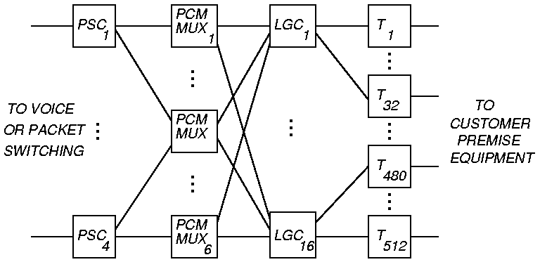
Lucent Technologies
Integrated Services Data Network (ISDN) Switch

Slide 24
Lucent Technologies ISDN Phone Switch Hardware
PCM Pulse Code Modulation
Uses loop back of intermediate ports in switch for testing
BIST increased system logic gates by 4 %
BIST circuit pack area overhead: 1 %
  Slight yield decrease
Obtained 60% stuck-fault coverage with BIST
  Big improvement over fault coverage obtained with external ATE
Diagnostics were easier to write with BIST and ran 8 times faster

Slide 25
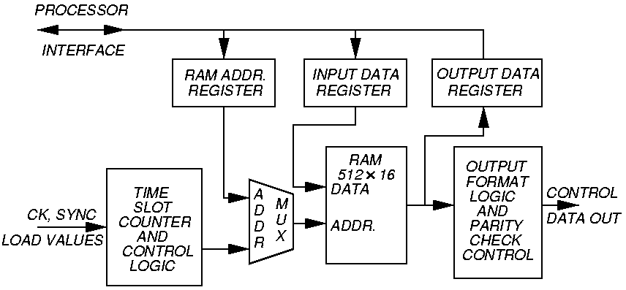
Lucent Technologies Example
Control RAM

Slide 26
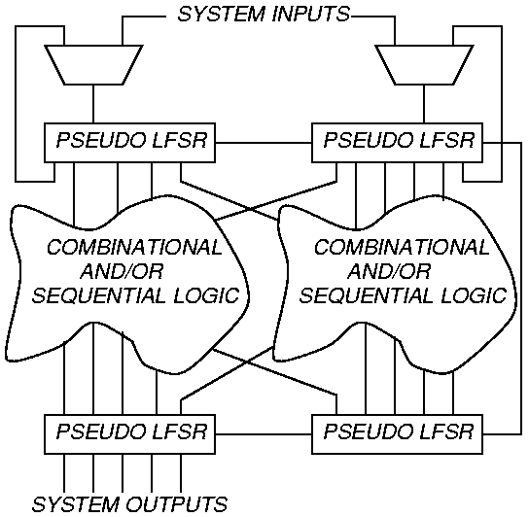
Circular BIST Usage

Slide 27
Success of Circular BIST at Lucent
Achieved 98 % fault coverage on tests for these memory faults:
  SAF
  Transition
  NPSF
98 % stuck-at fault coverage for random logic
Advantage: Can test mixture of random logic and memory

Slide 28
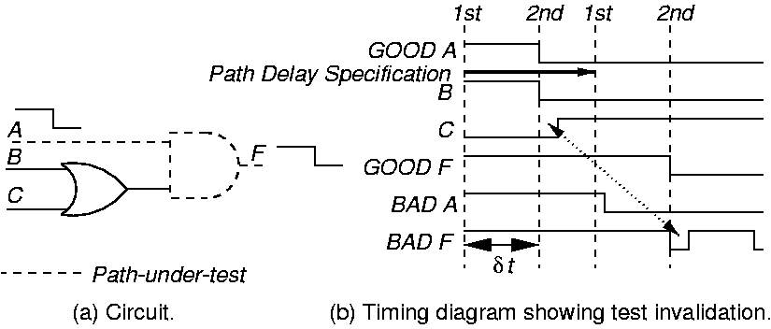
Delay-Fault Testing Hazard Problems
Delay distributed along dotted path – wires and logic gates

Slide 29
Delay Fault Test Generators
Test Invalidation Problem:
  Delays in off-path wires (not being tested) confuse the testing process and cause the process to conclude that the path-under-test is good, when in fact it has a severe delay fault
  Occurs because the hazard is sampled, rather than the final transition on the path
Signal input changing (SIC) pattern generator reduces invalidation -- two known methods:
  Use Gray Code pattern generator
  Use Johnson counter (alternate mode is LFSR)

Slide 30
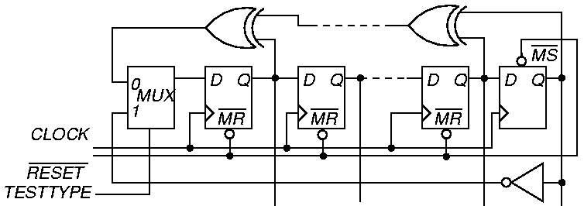
Delay-Fault BIST Pattern Generation

Slide 31
Summary
BIST is gaining acceptance for testability insertion due to:
  Reduced chip area overhead (only 1-3 % chip area for memory BIST)
  Allows partitioning of testing problem
Memory BIST – widely used, < 1 % overhead
Random logic BIST, 13 to 20 % area overheads
  Experimental method has only 6.5 % overhead
  Used by IBM and Lucent Technologies in selected products
Delay fault BIST – experimental stage

